Slide 1
The legend of Mr. Twardowski

Slide 2
Legend describes Jan Twardowski as a 16th-century nobleman living in Cracow. It is still not certain whether the hero who inspired the creation of the legend really existed or was just a figment of the imagination. He is also known as Master Twardowski and Polish Faust.

Slide 3
Jan Twardowski was an educated man, he loved books and science. He was interested in magic and alchemy. However, after many years of research, he concluded that witchcraft is not possible without the participation of supernatural forces. In one of his books he found information about summoning devils and followed the instructions.

Slide 4
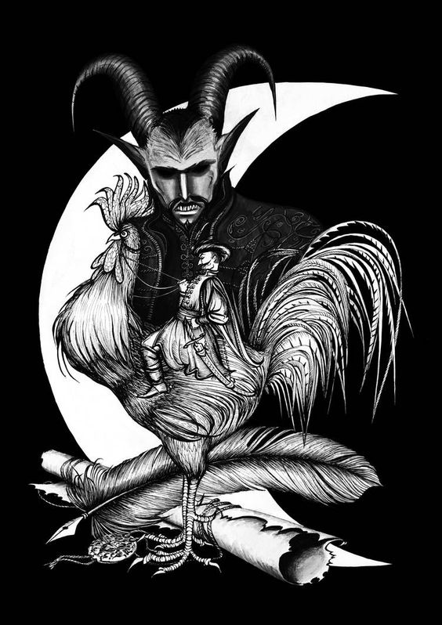
He summoned the devil and then started a conversation with him about witchcraft. Concluded an agreement under which Twardowski was to give his soul to the devil in exchange for the skill of practicing magic. The man offered to give his soul to the devil as soon as he was in Rome, where he planned to leave soon, but he had no intention of visiting this city.

Slide 5
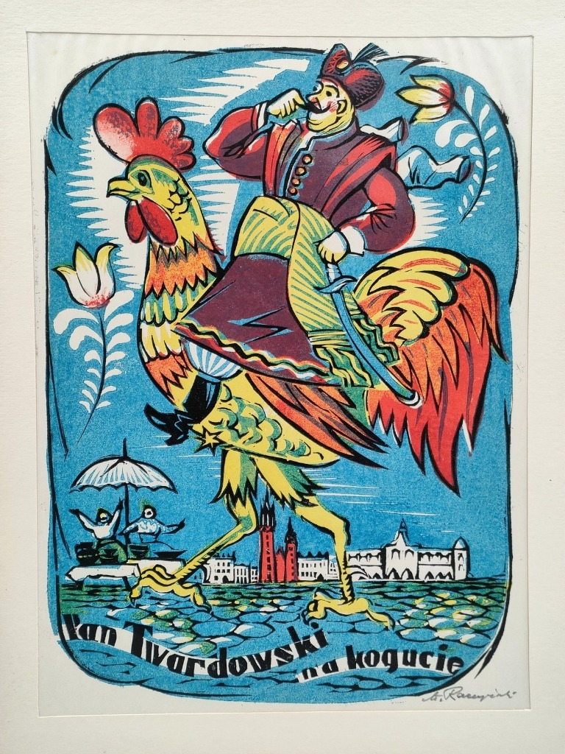
He traveled the country on a great rooster and healed people, what the devil did not like. He turned into a boy and asked for help for his sick mother. In this way he brought Twardowski to an restaurant called Rome.
Then the devil caught him and demanded his soul. However, Mr. Twardowski did not want to give up without a fight. Raised higher and higher, he began to pray to the Holy Mother. Finally, the devil weakened and released him from his paws. The falling nobleman landed on the moon and stayed there until today.

Slide 6
The end
Made by : Ania Stokłosa

